Slide 1
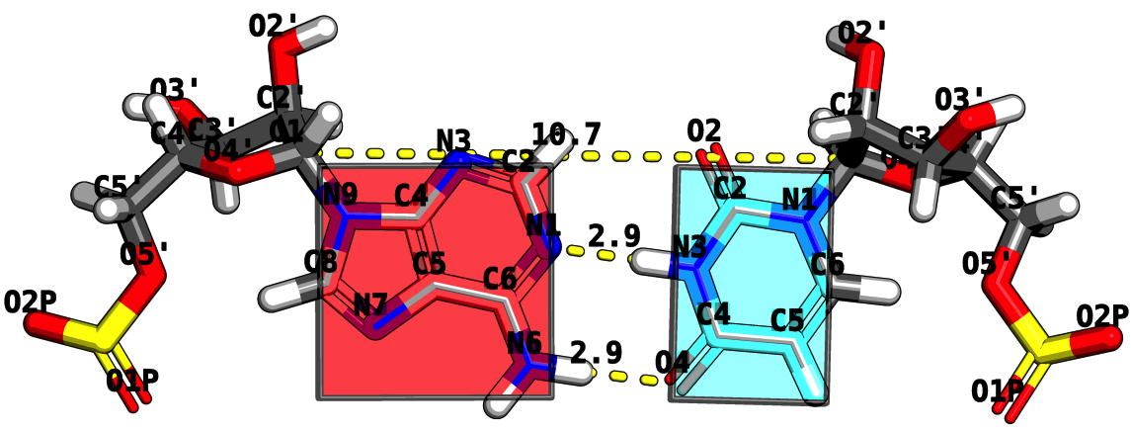
RNA Structure Analysis via the Rigid Block Model
Mauricio Esguerra
October 27th, 2010
Chemistry and Chemical Biology Department
Rutgers, The State University of New Jersey

Slide 2
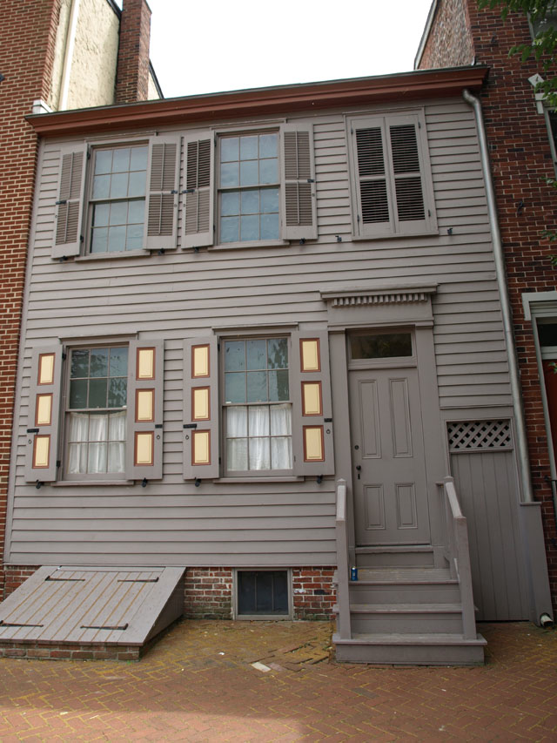
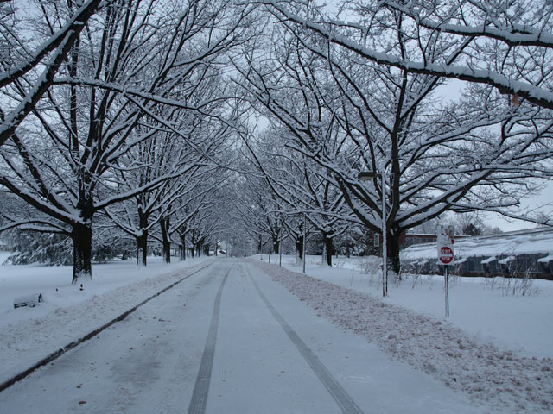
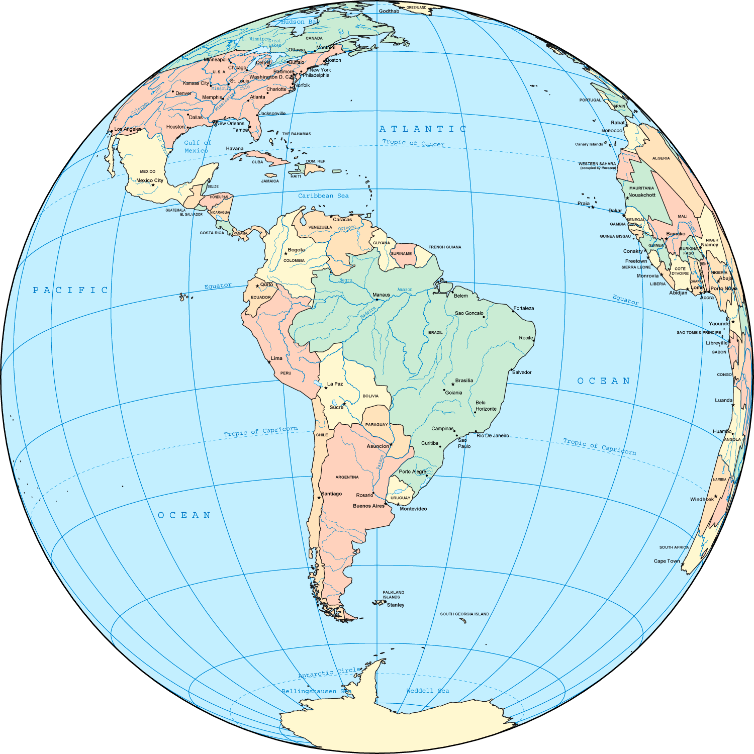
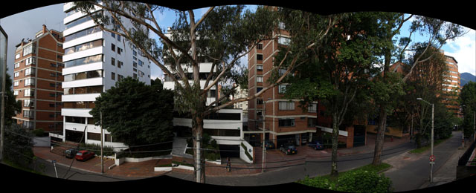
My neck o’ the woods

Slide 3
Program
Opening Act
THE CHALLENGE: How does RNA fold?
Act I
RNA BASE STEPS: Dinucleotide step classification using single-stranded base step parameters.
Act II.
RNA BASE PAIRS: Base pairs in RNA helical regions.
Act III
RNA BASE PAIR STEPS: From local to global properties in RNA with the aid of rigid-blocks.
Act IV
RNA STRUCTURAL MOTIFS: RNA structural motifs identification using rigid-blocks.
Finale
Notes:
Change it to Act I, Act II, etc. → Intermezzo.

Slide 4
Opening ACT
THE CHALLENGE:
How does RNA fold?
Is this an easy or hard problem?

Slide 5
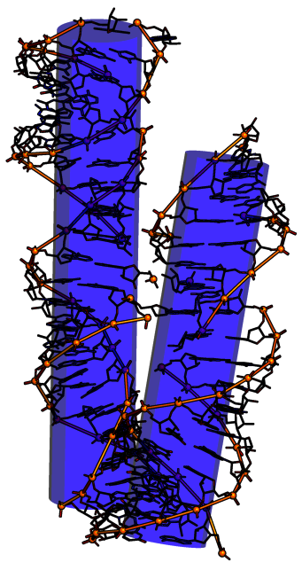
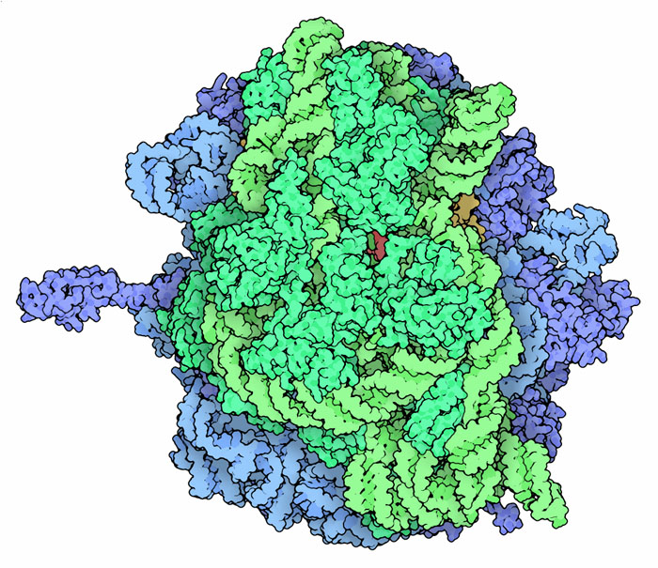
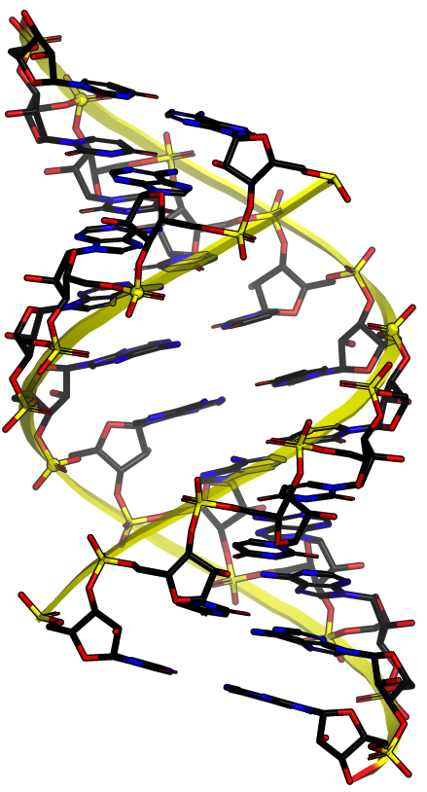
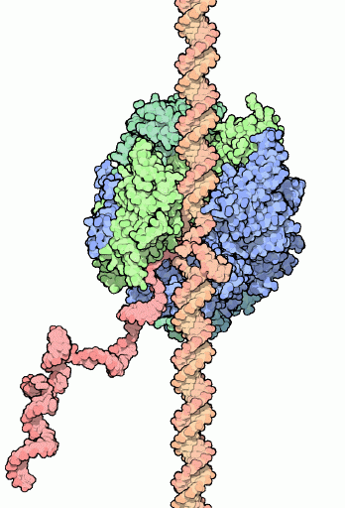
CHALLENGE What is RNA? A structure that can give you a Nobel prize or not.
TRANSLATION
Ribosome, aka rRNA
Protein factory
2009 Nobel
Ribozymes
1989 Nobel
TRANSCRIPTION
RNA Polymerase
mRNA factory
2006 Nobel
A-RNA
No Nobel
Notes:
A-RNA 1956 Alex Rich
Tetrahymena themophila self splicing sequences. Sidney Altman and Tom Cech
RNA polymerase. Rogerd D. Kornberg
Ribosome. Ada Yonath, Tom Steitz, Venkatraman Ramakrishnan
Ribozyme is H2 an H2 of Group II Intron, 3bwp

Slide 6
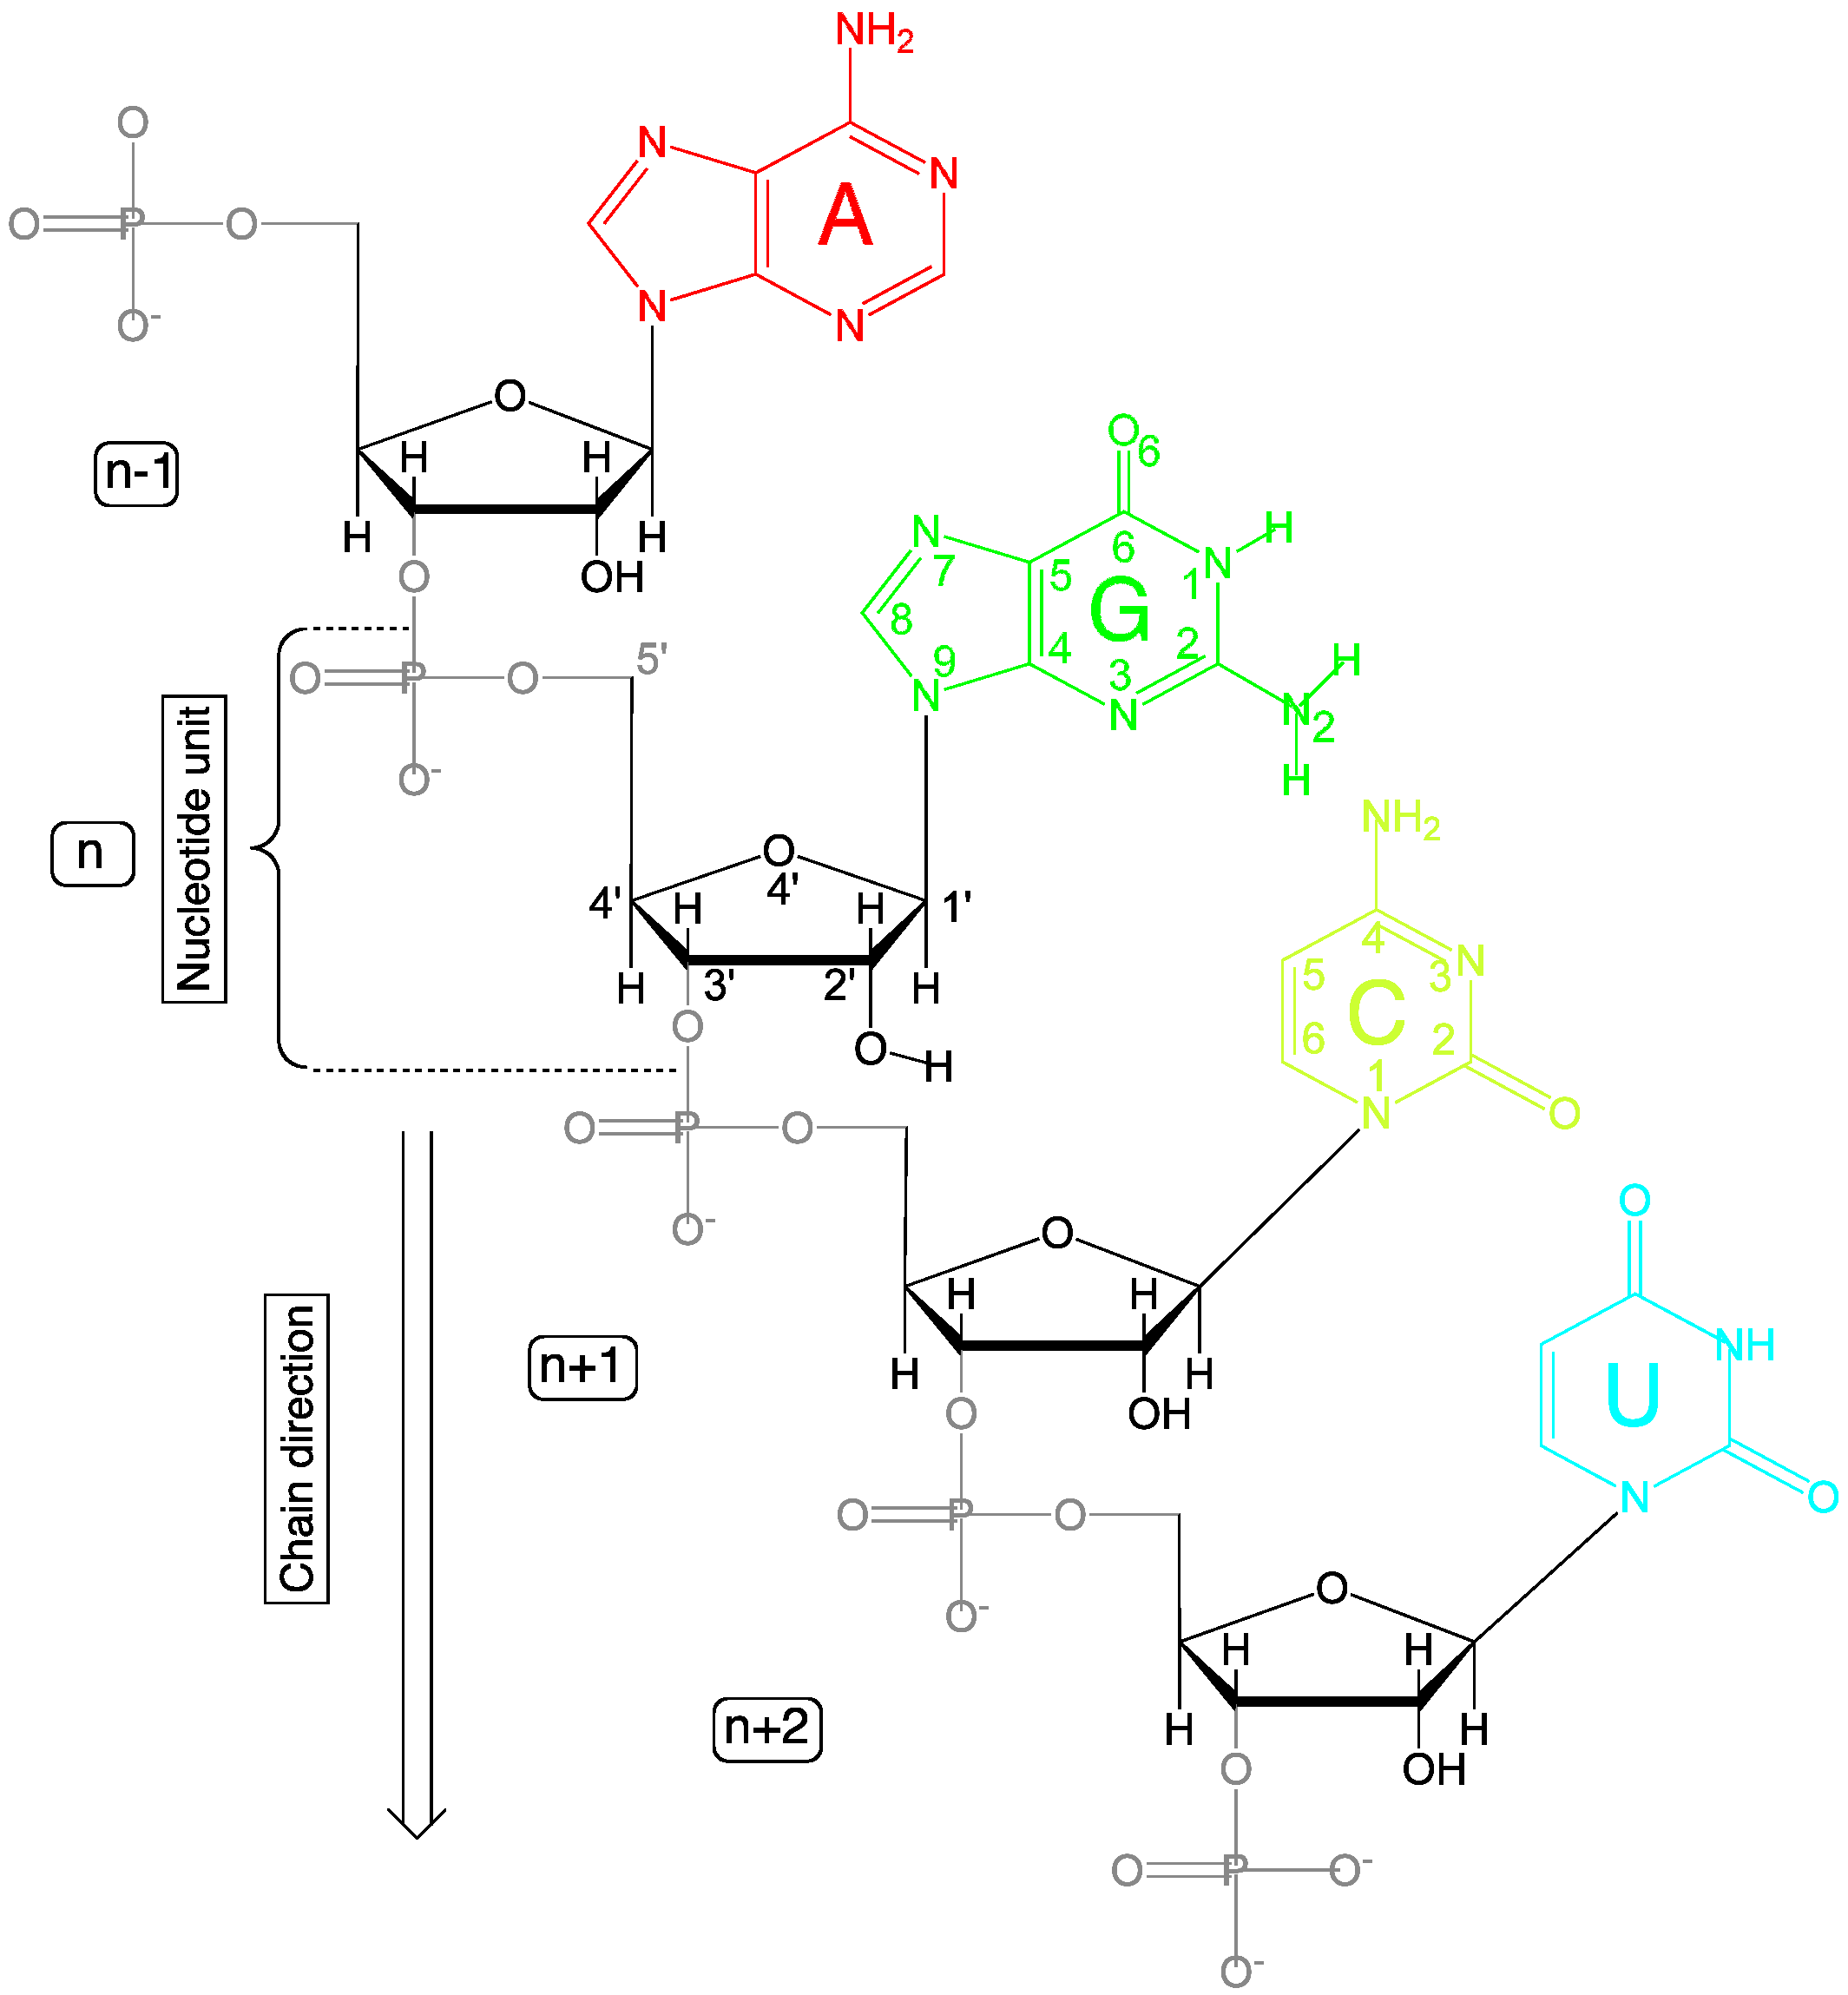
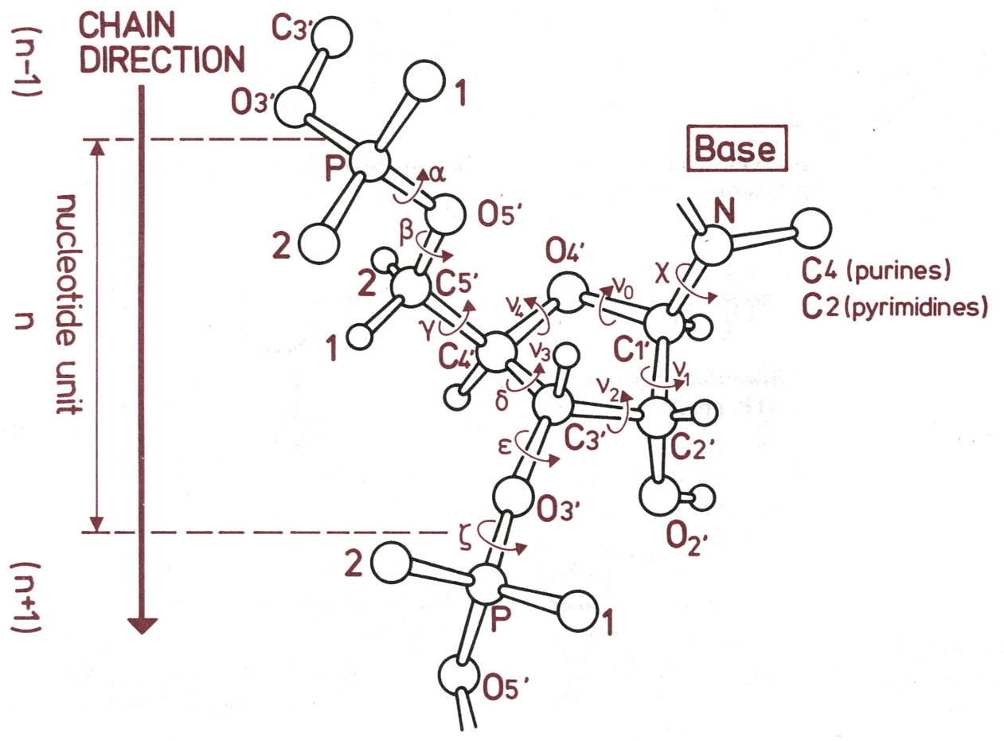
CHALLENGE RNA is composed of units (nucleotides) that have a base, a sugar (ribose), and a phosphate group.
6 Nucleic acid torsion angles.
1 Glycosidic torsion angle.

Slide 7
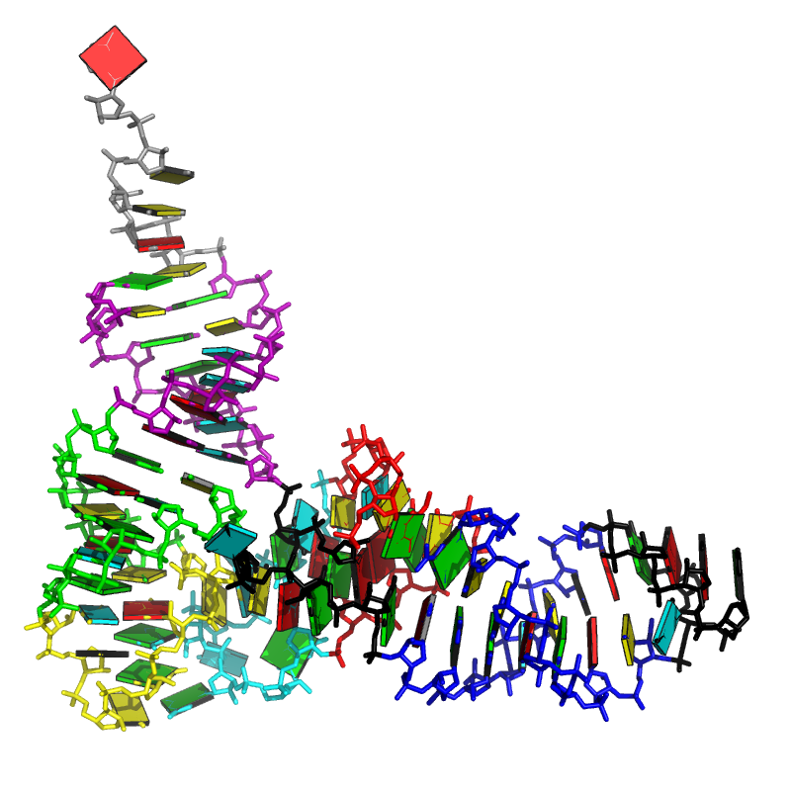
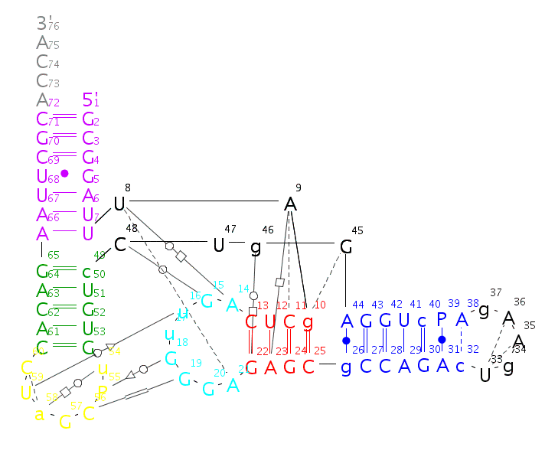
CHALLENGE How does the RNA polymer fold?
Primary
GCGGAUUUAGCUCAGUUGGGAGAGCGCCAGACUGAAGAUCUGGAGGUCCUGUGUUCGAUCCACAGAAUUCGCACCA
Secondary
Tertiary

Slide 8
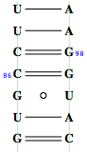
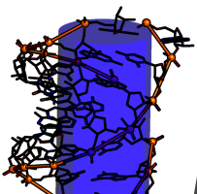
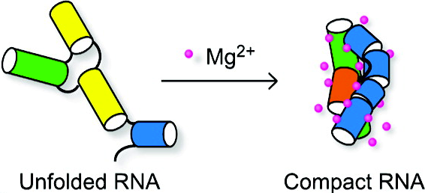
CHALLENGE Is RNA folding a hard or easy problem to solve? After all, the RNA alphabet has only 4 letters.
In contrast to proteins, no hydrophobic surface burial.
Polyanionic sugar-phosphate backbone.
Secondary and tertiary separated by Mg2+ addition.
Slow folding compared to protein ~ 1ms.
Notes:
High Mg 2+ concentration means 5mM according to Sarah Woodson @ John’s Hopkins.

Slide 9
CHALLENGE From a structural point of view what can we say or contribute to the RNA folding problem?
How do RNA structural properties influence RNA folding?
What can we say about helical regions using common methods used in the Olson lab, e.g. rigid-body models?
How can we define RNA motifs?
What are RNA motifs?

Slide 10
CHALLENGE Usual ways to classify RNA conformations and an unexplored one -- the rigid-body perspective --.
The atom-based perspective
Comparison of backbone atom positions.
Comparison from set of backbone, sugar, base, atom positions.
The bond-based perspective
Covalent bonds – backbone + glycosidic torsions.
Pseudo-bonds η and θ.
Hydrogen bonds forming in edge boundaries (Watson-Crick, Sugar, and Hoogsten).
The rigid-body-based perspective
Base-pair parameters.
Base-pair (base) step parameters.

Slide 11
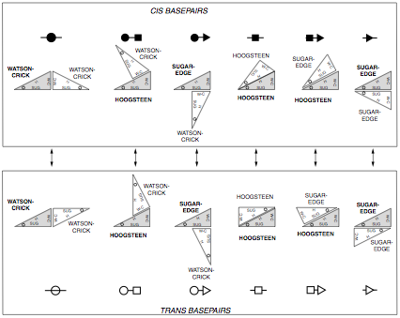
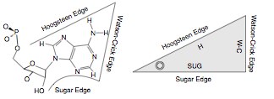
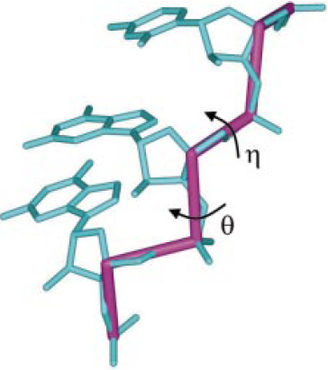
CHALLENGE: Bond perspectives Leontis-Westhof base-pair classification based on base boundaries. Pseudo-bond torsion angles.
Leontis-Westhof boundaries
Torsion angles of pseudo-bonds
Notes:
Nabla between C4’ n-1 to Pn to C4’ n to P n+1
Theta between Pn to C4’n to Pn+1 to C4’ n+1

Slide 12
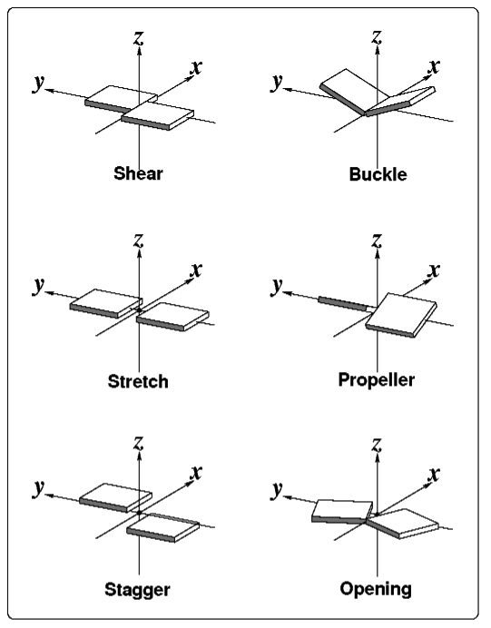
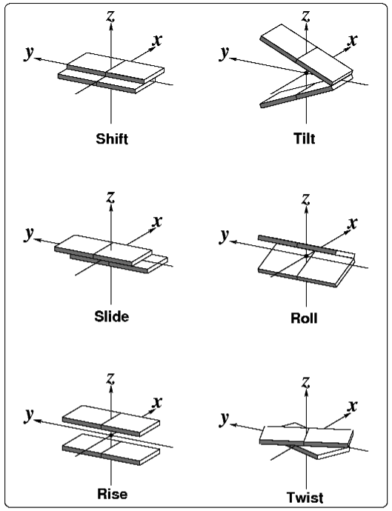
CHALLENGE The rigid-body perspective: Nucleic acid bases and base-pairs represented as blocks.
Base-pair parameters
Base-pair-step parameters

Slide 13
ACT I
Dinucleotide step classification using single-stranded base step parameters
Notes:
Look at what is before ACT, to give it a name as motivation.

Slide 14
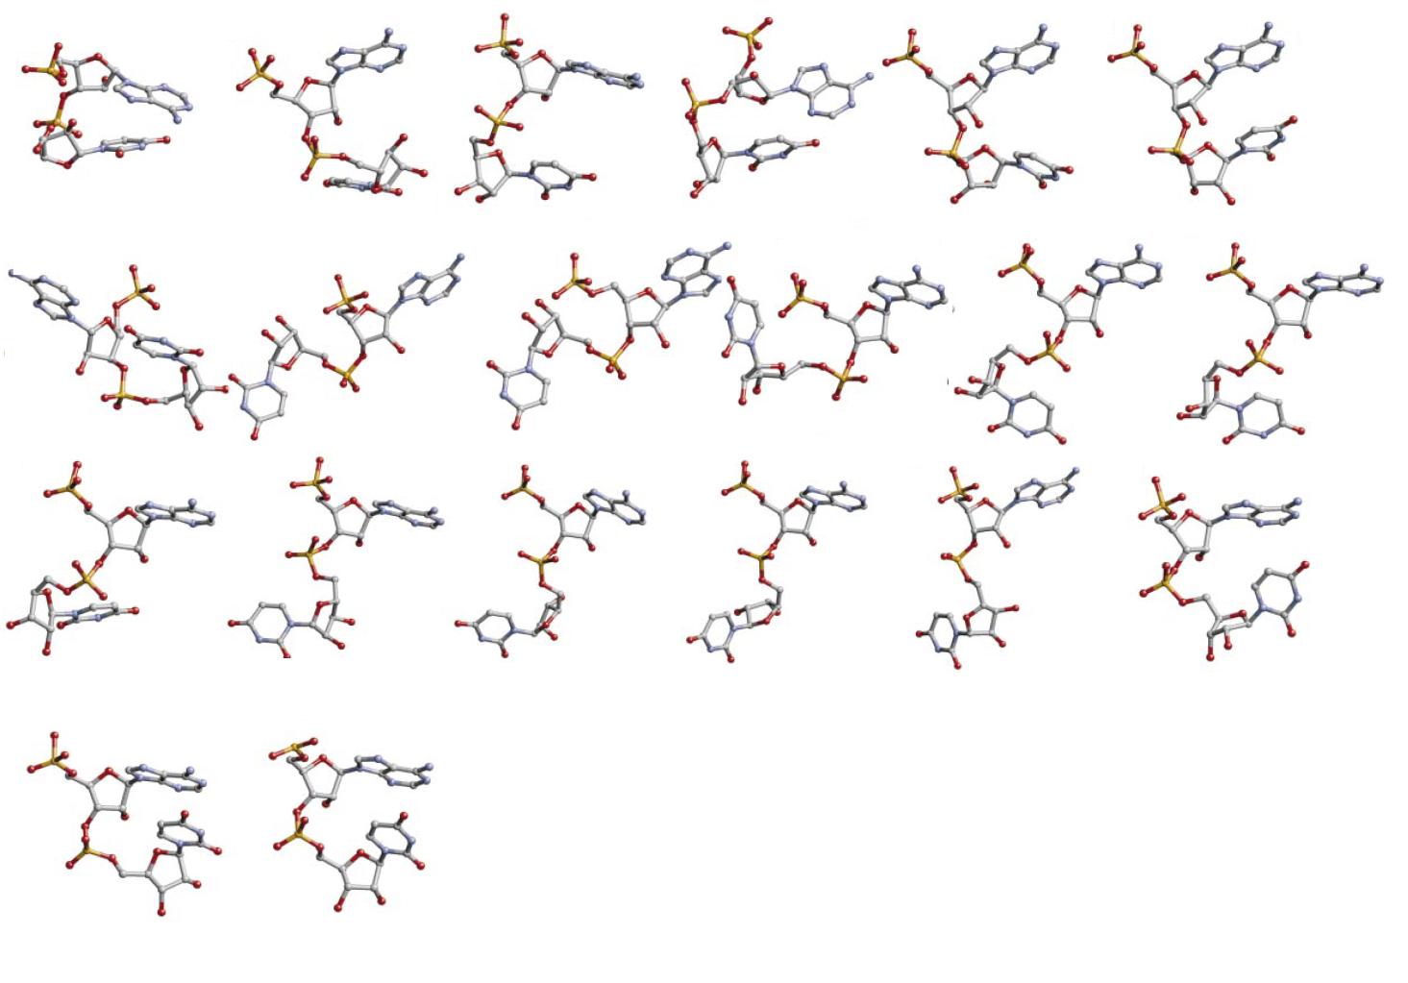
I. BASE STEPS 18 non-A-RNA, AII-RNA, and canonical A-RNA conformers kindly provided by Berman and collaborators.
1
2
3
4
5
6
Non
A-RNA
7
8
9
10
11
12
13
14
15
16
17
18
19
20
Schneider et al. (2004) NAR, 32, 1667-1677.
AII-RNA
A-RNA
Notes:
Say that from distribution of torsion angles instead than from torsion angle alone, which would be interpreted as continuous function.
Fourier transform are made of a distribution of points picking three torsion angles at a time (tau1, tau2, tau3), then a second Fourier transformation is made to calculate pseudo-electron densities. The techniques applied are common crystallographic techniques and crystallographic software was adapted to obtain the pseudo-electron densities. And after analysis of pseudo-electron densities lexicographical clustering is performed.

Slide 15
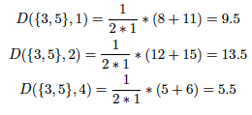
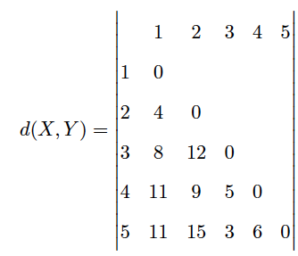
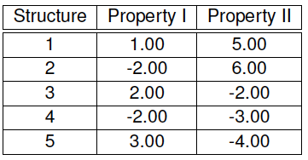
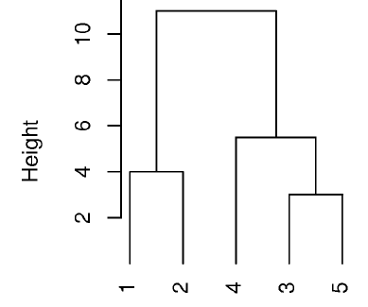
I. BASE STEPS: Clustering techniques I Simple example on hierarchical clustering. Consensus clustering uses idea of branch consensus.
Dataset
Distance matrix
(manhattan)
Group using a method.
(average linkage)
Notes:
Explain clustering techniques. D(2,3) = |-2-2| +|6- -2| = 12
Use both pictures In appendix.
Explain hierarchical and validation on the sense of what validation scores aim to do.

Slide 16
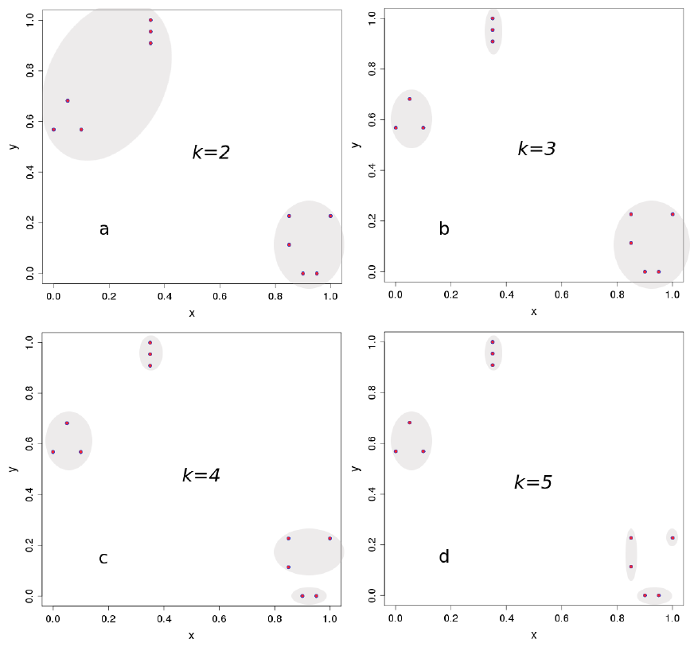
I. BASE STEPS: Clustering techniques II Validation using scores which quantify compactness, connectedness, and separation.
k=3 is more compact
and separated than others.
Scores such as Dunn Index
and ASW, quantify this.
k=2 is more connected.
Conectedness decreases
progressively as the number
of clusters increases.
Notes:
ASW = Average Silhouette Width. Good above 0.5, below 0.2 should not be considered.

Slide 17
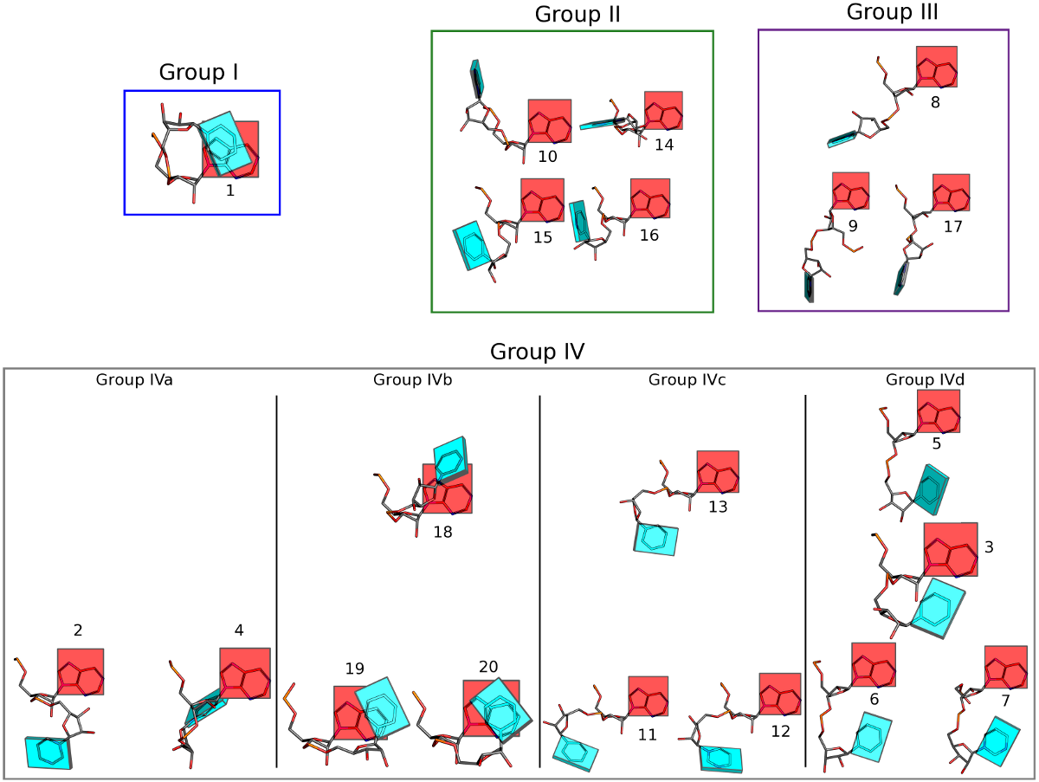
A-RNA

Slide 18
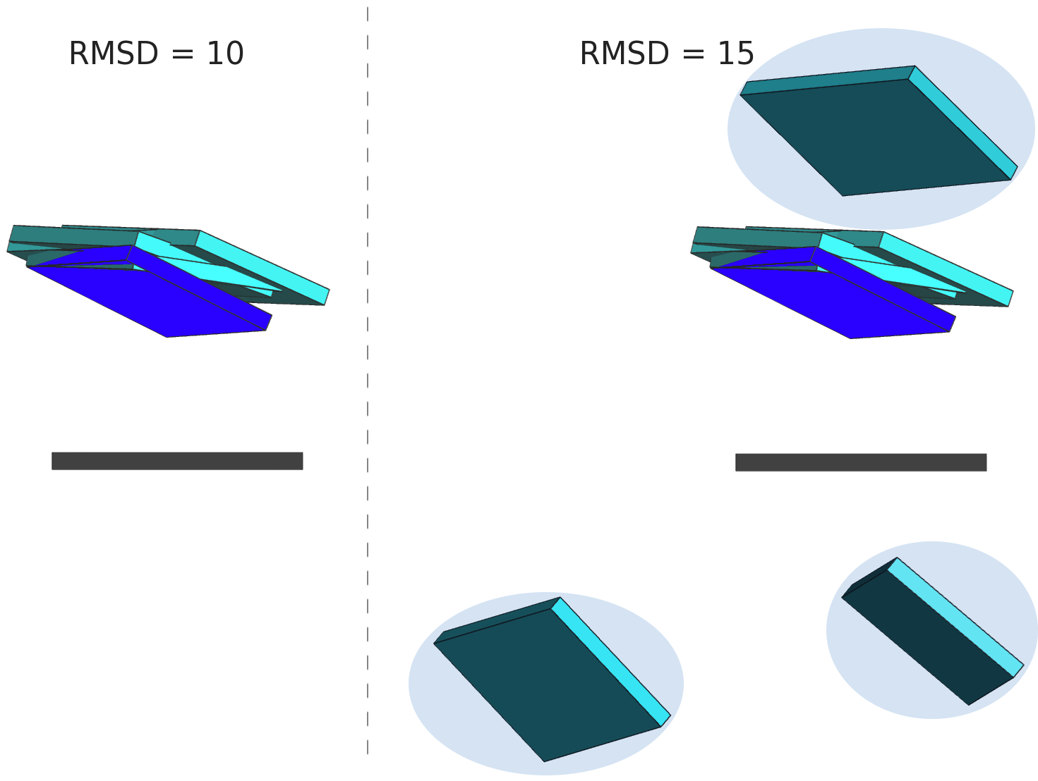
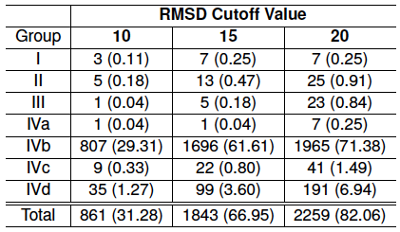
I. BASE STEPS Only a small fraction ~ 30 % of dinucleotide step conformations are represented in the ribosome.
In parentheses percentages of
confomer groups found in the 23S
subunit of the ribosome, PDB_ID: 1JJ2
Notes:
Subscript what’s in parentheses.

Slide 19
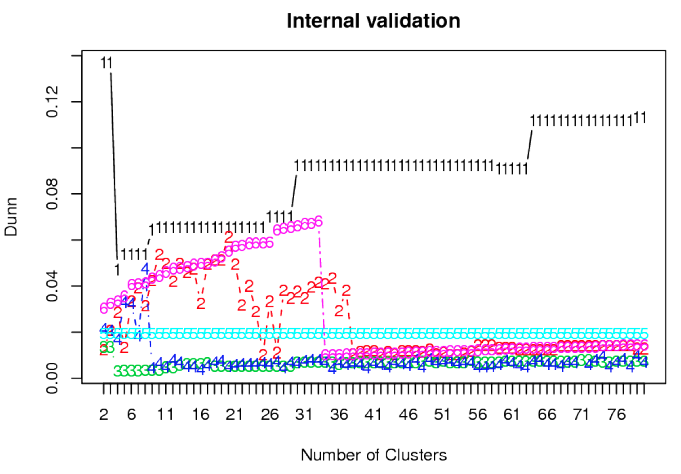
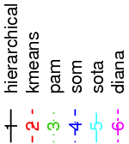
I. BASE STEPS Instead of picking any clustering methodology we use the clValid R package for cluster validation.
Clustering methods
Validation Scores
Dunn Index large
Connectivity small
Silhouette large
Notes:
SOTA: Second-Order Tolerance Analysis. SOM: Self Organizing Maps PAM: Partitioning around medoids.
Mention that the full validation method uses three scores with various clustering methods, not only Dunn Index which measures compactness and separation.

Slide 20
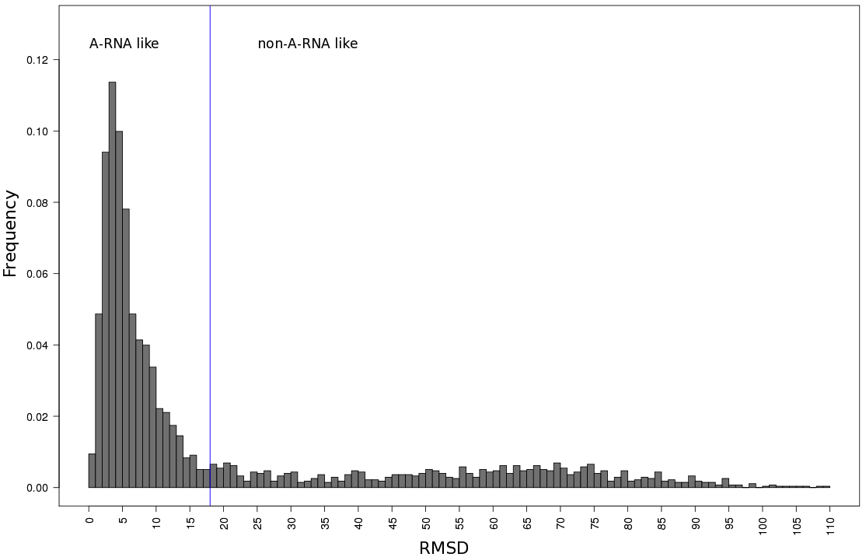
I. BASE STEPS Selecting A-RNA and non-A-RNA-like datasets using distance to canonical A-RNA parameters.
71% (1956)
29% (797)

Slide 21
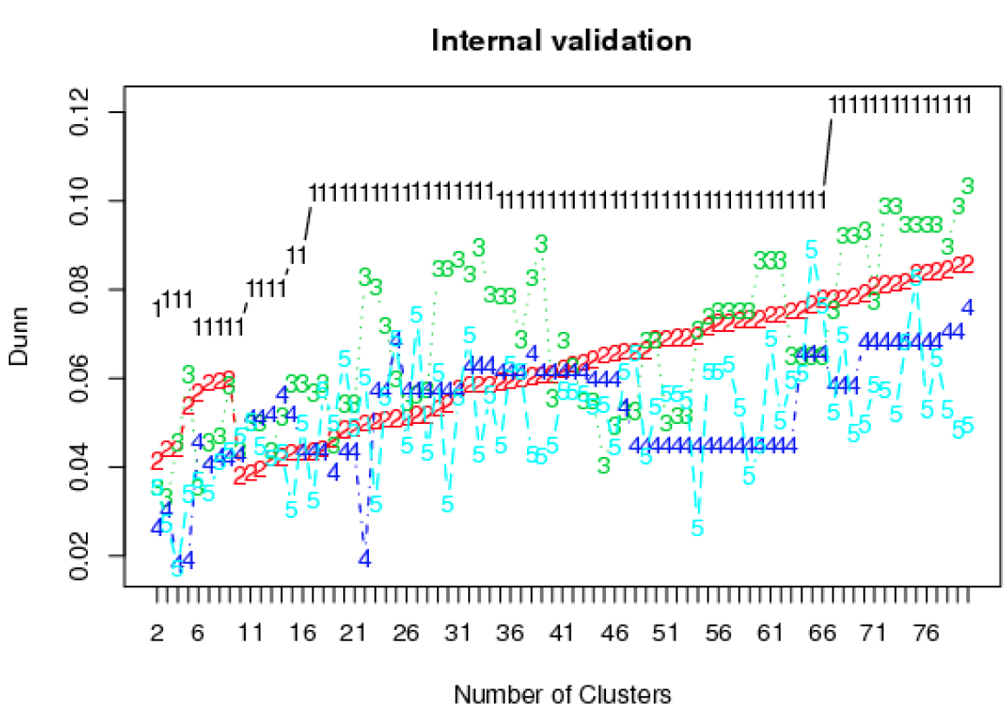
I. BASE STEPS For the non-A-RNA-like dinucleotide steps the best clustering method is the hierarchical one. k =67.
Clustering methods
Validation Scores
Dunn Index large
Connectivity small
Silhouette large
Notes:
Make sign at k=67
Make labels clearer
Make label of score trends better when.

Slide 22
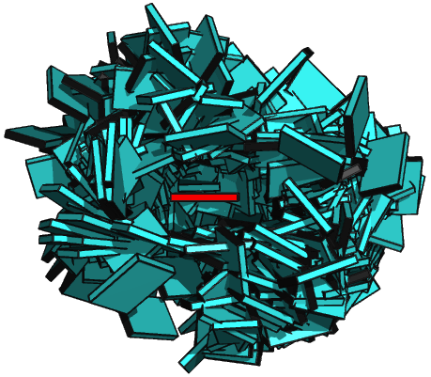
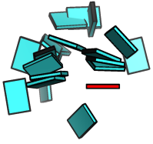

I. BASE STEPS Non-A-RNA-like torsion angle conformers do not fill the full space of base geometries.
A-RNA
17 non-A-RNA-like
All non-ARNA
797 (~30% of 23S rRNA)
Notes:
Type what are all the groups.
Show the 67 I get, as averages and show that they fill the space better.
Show picture of all.
How many in all non-ARNA

Slide 23
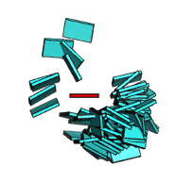
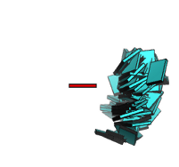
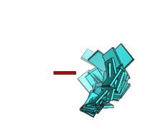
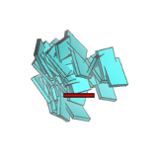
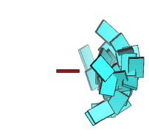
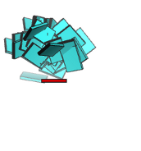
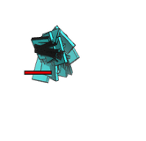
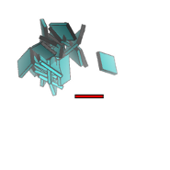
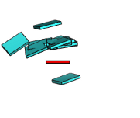
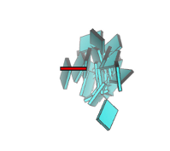
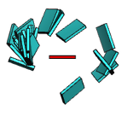
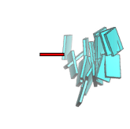
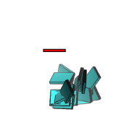
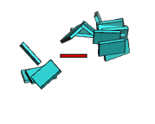



I. BASE STEPS 17 Main Non-ARNA-Like Clusters with ten or more members compose 80% of all non-A-RNA steps.
g2(12%)
g5(11%)
g3(8%)
g4(7%)
g7(6%)
g1(6%)
g9(5%)
g16(4%)
g11(4%)
g14(4%)
g13(3%)
g17(3%)
g8(2%)
g22(2%)
g33(2%)
g23(1%)
g32(1%)
Notes:
Include percentages of each group in non-ARNA.
What are the missing groups?
How many do 17 represent, the percent.

Slide 24
ACT II
Base-pairs in RNA helical regions

Slide 25


II. BASE PAIRS Helical regions in 3DNA can be continuous and quasi-continuous.
Continuous helical region
Quasi-continuous helical region
Notes:
Picture of helical regions in 3D, quasi continuous vs continuous.
Base-pairing preferences, base-sequence preferences, which can be linked to tertiary interactions.

Slide 26

II. BASE PAIRS Partially non-redundant RNA dataset is GC rich.
Helices composed of 3 base-pairs or more
Notes:
MESSAGE HERE THAT ITS GC RICH

Slide 27

II. BASE PAIRS Seven predominant base-pairs in RNA helical regions make up to 90% of all base-pairs.
In subscript the percentage
of base-pair structures which
comply to the hydrogen bonding
pattern shown in column II.
In parentheses the standard
deviations for the atomic
distances of the hydrogen
bonding patterns.

Slide 28

II. BASE PAIRS Non-canonical base-pairs are more deformable than canonical base-pairs.
Notes:
Use word volume but don’t explain that it’s product of eigenvalues.

Slide 29


II. BASE PAIRS Most deformed base-pairs seem as oversized or undersized pieces in a puzzle.

Slide 30
ACT III
Base-pair-steps in RNA helical regions and RNA global properties

Slide 31

III. BASE PAIR STEPS 21 unique base-pair steps formed by canonical Watson-Crick base-pairs and G.U wobble.

Slide 32

III. BASE PAIR STEPS RNA base-pair-steps in helical regions are still few when non-canonicals are considered.
Not all possible combinations of base-pairs into base-pair steps
are found in the studied helical regions.
Sheared A.G and U.Uw stand-out.
Number of base-pair steps in RNA helical regions

Slide 33
III. BASE PAIR STEPS RNA base-pair-steps parameters in helical regions and energy contours. The rnasteps website.
http://rnasteps.rutgers.edu

Slide 34
Intermezzo

Slide 35


III. BASE PAIR STEPS – GLOBAL Knowledge of adjacent base-pair steps makes it possible to make up a larger polymer.
With average base-pair-step
parameter values from
RNAsteps.rutgers.edu we can
model larger polymers.

Slide 36



III. BASE PAIRS STEPS – GLOBAL RNA sequence has subtle effects on the structure of RNA.
Homopolymers
Block Copolymers

Slide 37


III. BASE PAIR STEPS – GLOBAL Global properties of polymer chains. Persistence length a.
Porod-Kratky
Notes:
Show that persistence length is not isotropic
Appendix descriptions of persistence length
Maybe pictures making sense of component of projection definition.

Slide 38

III. BASE PAIR STEPS – GLOBAL There might be sequence dependence on the persistence length.
Experimental values
Cyan and magenta Hagerman
Purple and yellow Abels et al.

Slide 39

III. BASE PAIR STEPS – GLOBAL Surprisingly some RNA polymeric chains appear to be curved.
Notes:
FIX GRAPH

Slide 40

III. BASE PAIR STEPS – GLOBAL poly r(AC)₃G₅ • poly rC₅(GU)₃

Slide 41

III. BASE PAIR STEPS – GLOBAL Modelled vs. Experimental a In range with Hagerman, higher than Abels et al.
Persistence length derived from X-ray structure analysis suggests than RNA is stiffer than DNA and in the range of Hagerman but slightly higher than Abels and Dekker.

Slide 42
ACT IV
Finding RNA structural motifs using base step parameters.

Slide 43

IV. RNA STRUCTURAL MOTIFS getMotif: A simple program to find RNA motifs based on single stranded base step parameters.
getMotif uses a seed of single-stranded
base step parameters to apply a sliding
window technique to localize RNA
structural motifs in any RNA structure
given in pdb format.

Slide 44



IV. RNA STRUCTURAL MOTIFS Testing the getMotif program using the GNRA Tetraloop Motif
GNRA tetraloop provides
good “toy” model to test getMotif
The first step in GNRA is quite far
from canonical A-RNA. NR, and RA
Steps are closer save for having
Greater slide and being over-twisted.

Slide 45

IV. RNA STRUCTURAL MOTIFS Sum of differences score for a sliding window finds potential GNRA tetraloop motif candidates.
Sum of difference score for the large
subunuit of the ribosome,
PDB_ID:1FFK, compared to the
GNRA tetraloops base steps.
Notes:
Make a sliding windows image.
An image with matrices in color which slides, remember Manju Bansal’s slides and Dr. Olson’s suggestion.

Slide 46



IV. RNA STRUCTURAL MOTIFS The sum of differences score between single stranded base steps recognizes two GNRA groups.
Group I
Group II
GNRA recognizes two GNRA-like
motifs.
In blue the “canonical” GNRA tetraloop motif. In red the lonepair triloop motif.

Slide 47


IV. RNA STRUCTURAL MOTIFS Group II candidate is the lone-pair triloop motif, or a composite GNRA motif.
The GNRA-like candidates apparently lacking the sheared G.A base-pair, form a lonepair triloop motif, which is just a structural GNRA motif, with a non-sequential closing base-pair.
Notes:
Make sure that group II is tied to previous picture,

Slide 48
FINALE Conclusions
Rigid-body analysis reveals missing conformations on classification of RNA dinucleotide steps which can be classified using rigid-body parameters.
Base pairs in RNA helical regions in X-ray structures arrange in seven predominant types.
Modelling using rigid bodies gives surprising results of RNA curving with specific sequences.
A new software for finding RNA motifs based on rigid-body parameters successfully finds the GNRA motifs and the closely related lone-pair triloop motif.
Notes:
Add conclusions to each act.
Future, open questions, coming attractions.
Passive voice.

Slide 49
FINALE Future and developing work.
Expand RNAsteps.rutgers.edu to periodically synchronize its data with the PDB in an automated fashion.
Construction of a dataset of base-step parameters for known RNA motifs to be used in the getMotif software.
Migrating the getMotif fully to python.
Develop a web-based front end to getMotif.
Develop a code for computing rigid-body parameters thinking of helical regions as rigid-bodies.
Notes:
Add conclusions to each act.
Future, open questions, coming attractions.

Slide 50

Thanks to my defense committee members for making it easy to schedule
this defense and your valuable time.
Special thanks to all members of the Olson Lab,
past and present.
Thanks to all for your attention,
Visit us at: http://dnaserver.rutgers.edu

Slide 51






BASE PAIR STEPS – GLOBAL Global properties of polymer chains. Persistence length.
Notes:
Show that persistence length is not isotropic
Appendix descriptions of persistence length
Maybe pictures making sense of component of projection definition.

Slide 52


Slide 53

BASE STEPS Instead of picking any clustering methodology we use the clValid R package for cluster validation.
Clustering methods
Clustering scores
Connectivity small
Silhouette large
Dunn Index large
SAVE IN THE BACK FULL PLOTS
Notes:
Put in notes what the acronym.

Slide 54

BASE STEPS For the non-A-RNA-like dinucleotide steps the best clustering method is the hierarchical one. k =67.
Connectivity small
Silhouette small
Dunn Index large
Notes:
Make sign at k=67
Make labels clearer
Make label of score trends better when.

Slide 55

BASE PAIR STEPS Energy contours on data culled by three standard deviations from the mean.
Notes:
This will just go from going into the website.

Slide 56
RNA STRUCTURAL MOTIFS Sum of differences score for a sliding window finds potential GNRA tetraloop motif candidates.
This is for 1FFK
Sliding windows image
Image with matrices in color
Boxes
e.g.
--- ---- ----
---- ---- -----
--- ---- ----
Notes:
Make a sliding windows image.
An image with matrices in color which slides, remember Manju Bansal’s slides and Dr. Olson’s suggestion.

Slide 57


